Slide 1
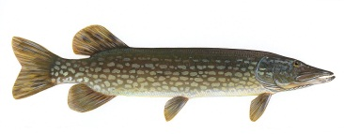
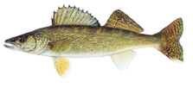
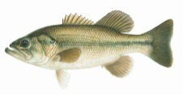
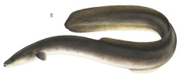
Progress towards Nearshore Zone Fish Community Objectives

Slide 2
NEARSHORE ZONE GOAL:
Protect, restore and sustain the diversity of the nearshore fish community, with an emphasis on self-sustaining native fishes such as Walleye, Yellow Perch, Lake Sturgeon, Smallmouth Bass, Largemouth Bass, sunfish, Northern Pike, Muskellunge, Round Whitefish and American Eel.

Slide 3
1.0 NEARSHORE ZONE GOAL: Protect, restore and sustain the diversity of the nearshore fish community, with an emphasis on self-sustaining native fishes such as Walleye, Yellow Perch, Lake Sturgeon, Smallmouth Bass, Largemouth Bass, sunfish, Northern Pike, Muskellunge, Round Whitefish and American Eel.
1.1 Maintain healthy, diverse fisheries - maintain, enhance and restore self- sustaining local populations of Walleye, Yellow Perch, Smallmouth Bass, Largemouth Bass, sunfish, Muskellunge, and Northern Pike to provide high quality, diverse, fisheries.
1.2 Restore Lake Sturgeon populations - increase abundance of naturally produced Lake Sturgeon to levels that would support sustainable fisheries.
1.3 Restore American Eel abundance - increase abundance (recruitment and escapement) of naturally produced American Eel to levels that would support sustainable fisheries.
1.4 Maintain and restore native fish communities - maintain and restore native nearshore fish communities, including species that rely on nearshore habitat for part of their life cycle.
Mixed
Progress
X
?
Notes:
During the last SOLO reporting period (2008-2013):
1.1 the results are mixed – the indicators are being met for some species (walleye, largemouth bass, sunfish) but not for others (eg pike)
1.2 the current status is well-below the indicator but progress is being made on the long-term restoration indicators
1.3 the current status is well-below the indicator but as of 2014 there were improvements in the long-term restoration indicator of increasing numbers coming up the ladder (the 2016 update will show that this trend has not continued)
1.4 the results are mixed – species richness and diversity indicators are being maintained in the Bay of Quinte and some other sheltered embayments – however Dreissenids and Round Goby have reset the benchmark for this FCO in the open coastal nearshore areas

Slide 4
Progress towards Offshore Pelagic Zone Fish Community Objectives

Slide 5
OFFSHORE PELAGIC ZONE GOAL
Maintain the offshore pelagic fish community, that is characterized by a diversity of trout and salmon species including Chinook Salmon, Coho Salmon, Rainbow Trout, Brown Trout, and Atlantic Salmon, in balance with prey fish populations and lower trophic levels.

Slide 6
2.0 OFFSHORE PELAGIC ZONE GOAL: Maintain the offshore pelagic fish community, that is characterized by a diversity of trout and salmon species including Chinook Salmon, Coho Salmon, Rainbow Trout, Brown Trout, and Atlantic Salmon, in balance with prey fish populations and lower trophic levels.
2.1 Maintain the Chinook Salmon fishery – maintain Chinook Salmon as the top offshore pelagic predator supporting trophy recreational lake and tributary fisheries through stocking, accounting for natural reproduction.
2.2 Restore Atlantic Salmon populations and fisheries - restore naturally produced populations to levels supporting sustainable recreational fisheries in the lake and selected tributaries and also provide recreational fisheries where appropriate through stocking.
2.3 Increase prey fish diversity - maintain and restore a diverse prey fish community that includes Alewife, Lake Cisco, Rainbow Smelt, Emerald Shiner, and Threespine Stickleback.
√
Progress
X
Notes:
During the last SOLO reporting period (2008-2013):
2.1 The indicators of the chinook salmon fishery were being met
2.2 some of the indicators of Atlantic Salmon restoration were being met while the indicator of adult salomon abundance were not being met
2.3 the indicator of prey fish diversity was not being met and was worstening

Slide 7
2.0 OFFSHORE PELAGIC ZONE GOAL: Maintain the offshore pelagic fish community, that is characterized by a diversity of trout and salmon species including Chinook Salmon, Coho Salmon, Rainbow Trout, Brown Trout, and Atlantic Salmon, in balance with prey fish populations and lower trophic levels.
Continued…
2.4 Maintain predator/prey balance - maintain abundance of top predators (stocked and wild) in balance with available prey fish.
2.5 Maintain Rainbow Trout (Steelhead) fisheries – maintain fisheries through stocking and, where appropriate, enhance naturally produced populations supporting recreational lake and tributary fisheries for Rainbow Trout.
2.6 Maintain Brown Trout and Coho Salmon fisheries – maintain the recreational lake and tributary fisheries for Brown Trout and Coho Salmon through stocking.
√
√
X
√
X
Notes:
2.4 the predator / prey balance was being maintained
2.5 in 2014 the rainbow trout fishery indicators were being met (as you will see in the upcoming presentations there is increasing concern about the status of this indicator and that for 2.4)
2.6 in 2014 the fisheries for brown trout and coho salmon were good in some locations – but in 2016 in NY waters the fisheries declined - unclear in Canadian waters

Slide 8
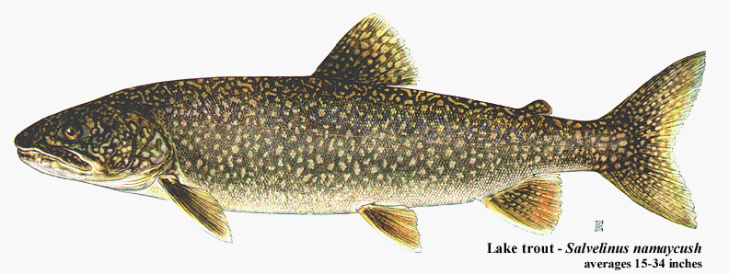
Progress towards Deep Pelagic and Offshore Benthic Zone
Fish Community Objectives

Slide 9
DEEP PELAGIC AND OFFSHORE BENTHIC ZONE GOAL
Protect and restore the diversity of the offshore benthic fish community composed of a mix of self-sustaining native species including Lake Trout, Burbot, Lake Whitefish, deepwater ciscoes, Slimy Sculpin, and Deepwater Sculpin

Slide 10
3.0 DEEP PELAGIC AND OFFSHORE BENTHIC ZONE GOAL: Protect and restore the diversity of the offshore benthic fish community composed of a mix of self-sustaining native species including Lake Trout, Burbot, Lake Whitefish, deepwater ciscoes, Slimy Sculpin, and Deepwater Sculpin.
3.1 Restore Lake Trout populations – restore self-sustaining populations to function as the top deepwater predator that can support sustainable recreational fisheries.
3.2 Increase Lake Whitefish abundance - increase abundance in northeastern waters and re-establish historic spawning populations in other areas.
3.3 Increase prey fish diversity – maintain and restore a diverse prey fish community that includes deepwater ciscoes, Slimy Sculpin, and Deepwater Sculpin.
3.4 Control Sea Lamprey – suppress abundance of Sea Lamprey to levels that will not impede achievement of objectives for Lake Trout and other fish.
Mixed
X
?
√
√
Notes:
During the last SOLO reporting period (2008-2013):
3.1 some positive indicators were observed for Lake trout resortation however there was not a self-sustaining population
3.2 whitefish populations had declined and there was very little sign of natural reproduction
3.3 it was too early to expect any results of deepwater cisco restoration efforts (will get update) the numbers of slimy was stable and the abundance of deepwater sculpins was increasing
3.4 indicators of success of sea lamprey control were positive

