Slide 1
2018 Report on Sea Lamprey Control in the Lake Michigan Basin
Lake Michigan Committee
Ypsilanti, Michigan
March 26, 2019

Slide 2
Fish Community Objectives
The Lake Michigan Committee established the following objective for Sea Lamprey control in Lake Michigan:
Suppress the Sea Lamprey to allow the achievement of other fish-community objectives

Slide 3
Fish Community Objectives
Sea Lamprey control has the most direct effect on achieving objectives for Lake Trout and other salmonines:
Establish self-sustaining Lake Trout populations
Establish a diverse salmonine community capable of sustaining an annual harvest of 2.7 to 6.8 million kilograms (6 to 15 million pounds), of which 20-25% is Lake Trout

Slide 4
Lampricide Control
Relatively light treatment season
Lampricide applications conducted in 9 streams and 1 lentic area
Notable treatments included Jordan River & lentic, and Little Manistee River
Campbell Creek (Paw Paw River) added to schedule after numerous large larvae were detected mid-summer

Slide 5
Lampricide Control
Rogers Creek successfully treated after deferral in 2017
Burns Ditch (Salt Ck-IN)- difficult treatment. Unsure MLC maintained for 9+ hours.

Slide 6
Larval Assessment
Larval assessment completed on 86 streams and 15 lentic areas
Surveys to estimate larval Sea Lamprey abundance were conducted in 26 tributaries
Larval populations estimated in 26 streams and 11 lentic areas for potential lampricide treatment
Surveys to detect the presence of new larval populations in 13 streams. No new populations found.

Slide 7
Larval Assessment
Post-treatment assessments completed on 24 tributaries to assess effectiveness of lampricide treatments in 2017 and 2018. Several streams to be retreated in 2019.
Barrier effectiveness surveys done in 21 tributaries with no positive detections found above barriers
Larval assessment surveys were conducted in 19 non-wadable lentic and lotic areas using 32.76 kg active ingredient of gB

Slide 8
Alternative Control and Evaluation
Barriers
GLFC has invested in 15 barriers; 7 purpose-built, 8 constructed for other purposes but modified to block SL
Field crews visited 46 structures to perform inspections and improve information in Barrier program database
Routine maintenance, spring start-up, and safety inspections were performed on 16 barriers
Consultations to ensure blockage at barriers were conducted on 14 sites in seven tributaries.

Slide 9
Little Manistee River
Working with MIDNR and USACE to improve blocking capability of Little Manistee weir and egg take facility during concurrent facility upgrade work being conducted by MIDNR.
Preliminary Restoration Plan completed for barrier and trap project. Includes improvements to weir and construction of permanent traps.
Draft Feasibility Study to be submitted this fall. Next steps include Detailed Design pending funding availability.

Slide 10
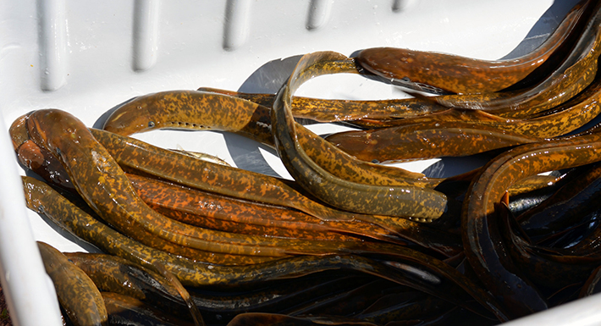
Boardman River / FishPass
Sabin Dam removed in 2018. Union St. Dam continues to serve as blocking structure on Boardman River
FishPass project design to be completed by end of year. Construction slated for early 2020 or 2021.

Slide 11
Manistique River-Barrier Repair
Dam failure leading to escapement in upper river
Biggest SL producer
Treatments since 2003 have cost ~$8 million
Final design 2019
Joint permit to DEQ 2020
Construction June 2021
History
MPI Dam constructed ~1920
New FERC regulations (1980s) – maintenance, safety
Decommissioned in 1991 – cost prohibitive

Slide 12
Grand River-6th Street Dam
Built mid-1880s
Deteriorating
Primary blocking structure
Protects > 2,000 mi
Proposed for removal
AHS 1 mi upstream
Field studies support SLCP concerns
Ongoing review/surveys

Slide 13
Adult Assessment
In 2018, SLCP changed the method used to calculate population estimates from M-R data. Changed from the Schaefer method to simpler Petersen method. Estimates updated for all index streams from 1980 to 2018.
11,491 Sea Lampreys captured at 9 tributaries during 2018 (6 index). Adult estimate based on M-R obtained for index locations.

Slide 14
Adult Index
Adult Index=26,999
95% CI (22,968-31,031)
5-year Avg. = 24,373
Adult Index=26,999
95% CI (22,968-31,031)
Target=38,703
Target=38,703

Slide 15
Juvenile Assessment
Lake Trout wounding data for Lake Michigan provided by FWS, MI, WI, IL, IN, CORA, and USGS
Provide a metric of lake-wide mortality inflicted on Lake Trout
Data analyzed by Green Bay FWCO

Slide 16
Wounding Rates
Target = 5

Slide 17
Lake Trout CPE

Slide 18
Risk Management
No program activities for Lake Michigan during 2018 field season

Slide 19
Other Activities
FishLamp-worked on model that relates adult SL abundance to LT abundance and wounding rates
SL Index variability-worked on model that relates adult SL abundance to environmental factors that could influence SL abundance or catchability
Continued research on pheromones to enhance trapping efforts. Also repellent compounds in lab and field.

Slide 20
2019 Plans Lampricide control
Treatments planned for 21 streams and 3 lentic areas including:
Manistique, Sturgeon, Whitefish, Peshtigo, Platte, Betsie, Manistee, and Muskegon rivers

Slide 21
2019 Plans Larval / Adult assessment
Larval assessments planned for 132 streams and 26 lentic areas
Treatment evaluations on 26 streams and one lentic area
Barrier effectiveness surveys on 5 streams
Surveys to detect possible new populations on 19 streams
Adult traps to be deployed in 8 streams (6 index, 2 non-index)

Slide 22
2019 Plans Risk Management
Collaborate with LRBOI and MIDNR on lake sturgeon collection efforts on Manistee and Muskegon rivers
Assess potential effects of TFM / 1% niclosamide mixture on Piping Plover adults and chicks at mouth of Platte River to support BA determination of “not likely to adversely affect”

Slide 23
2019 Plans Other activities
Supplemental control research
Trapping for Control
Impacts of dam removal scenarios on Lake MI sea lamprey population
Evaluate new trapping designs
Pheromone research-3kPZS work to continue on the Grand River (MI) in advance of the removal of 6th Street Dam / construction of replacement barrier
Alarm cue (repellent) research to continue at both dam and open water trap locations
Research on improving ability to intercept and trap juvenile sea lamprey

Slide 24
Maximum Larval Sea Lamprey Estimates in Lake Huron Streams, 1995-2012
Mississagi = 8,100,000
Garden = 7,000,000
St. Marys = 4,300,000
Saginaw = 2,700,000
Notes:
This slide helps to illustrate why we feel that action is urgently needed. The green circles on this map represent maximum larval sea lamprey production estimates for each tributary. In terms of production potential, the Mississagi and Garden rivers are capable of producing millions of sea lamprey larvae and rank 1 and 2 in Lake Huron.
If the larval populations in these two rivers remain uncontrolled, they will generate increasing numbers of parasitic juveniles each year, inflicting damage to Lake Huron fish stocks on a scale unparalleled since the 1950s.

Slide 25
Questions?

